Slide 1
Predict Loan Default Project on Python Batch- DSP 9-Mumbai
Group Members
Abhishek Khadse
Disha Lakhani
Nachiket Thakur
Rinkesh Ghadi

Slide 2
Introduction:
XYZ corporation
Objective
Data set size :
Observation: 855969
Variables: 73
Imbalanced dataset
Non defaulters : 809502
Defaulters: 46467

Slide 3
Introduction:
Overview:
1. Accuracy Paradox
2. The data contains defaulters, successful payers and customers who
were current during that time. To simplify the problem, customers
under 'current' status have been considered as non-defaulters in the
dataset.
3. Active /Inactive individuals
Inactive : 253030
Active: 602939

Slide 4
Exploratory Data Analysis
Summarizing the data
Anomalies
Feature Selection

Slide 5
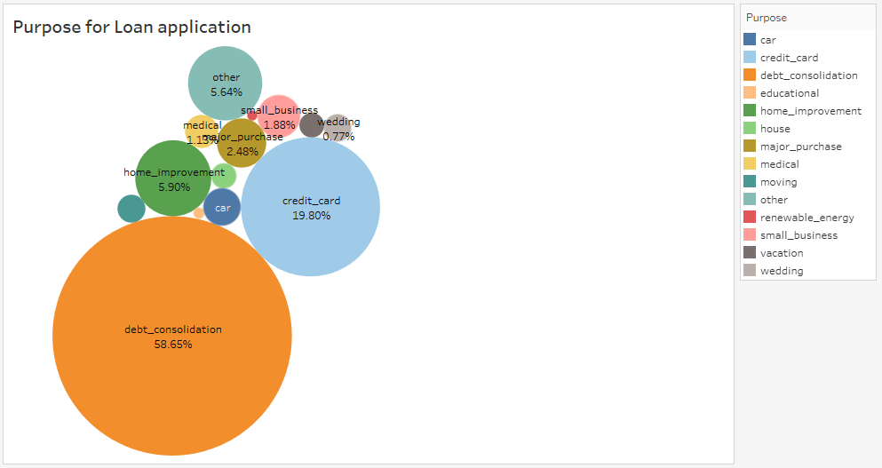

Slide 6
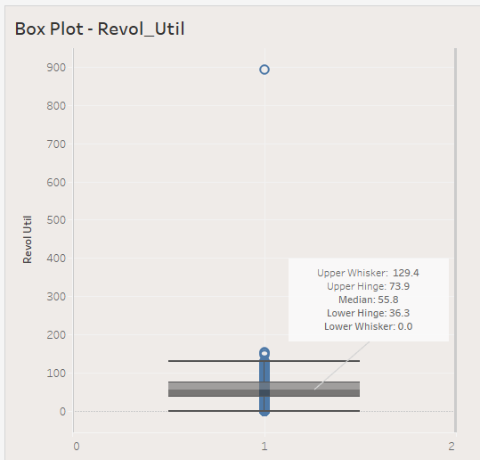
Outlier and anomalies in Revol_Util Column

Slide 7
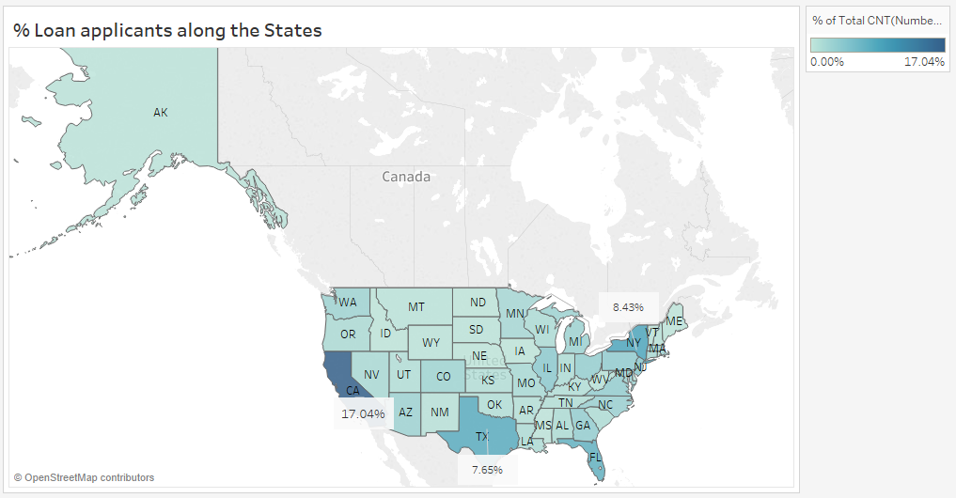

Slide 8
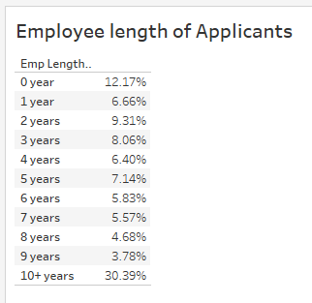

Slide 9
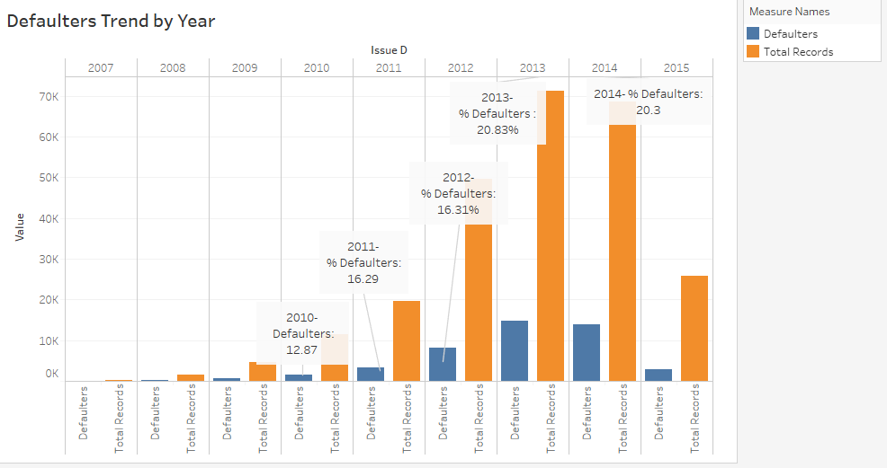

Slide 10
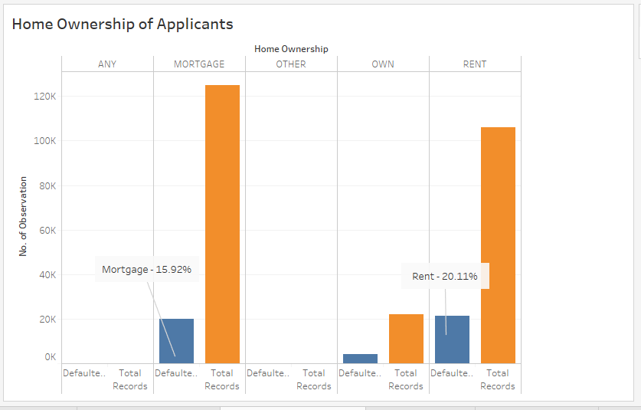

Slide 11
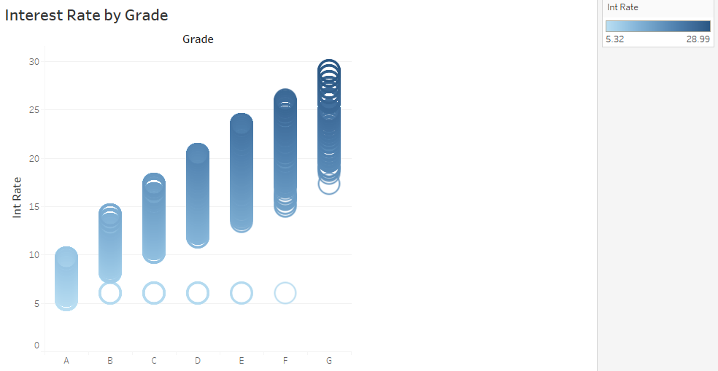
Maximum interest rate for grade:
A - 9.63, B – 14.09, C- 17.27, D- 21.31, E-23.4, F-25.99, G-28.99

Slide 13
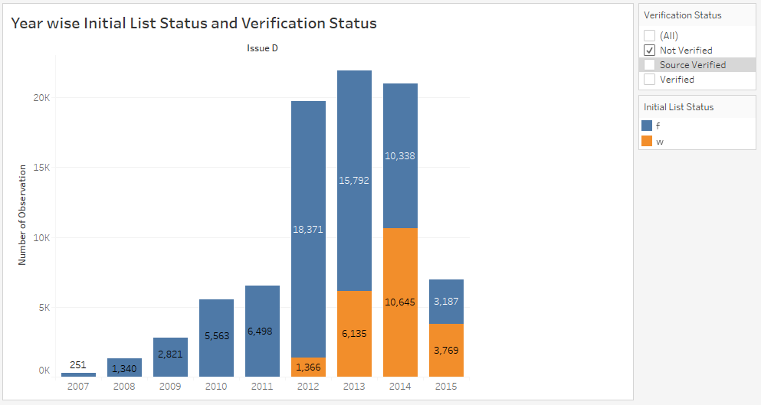
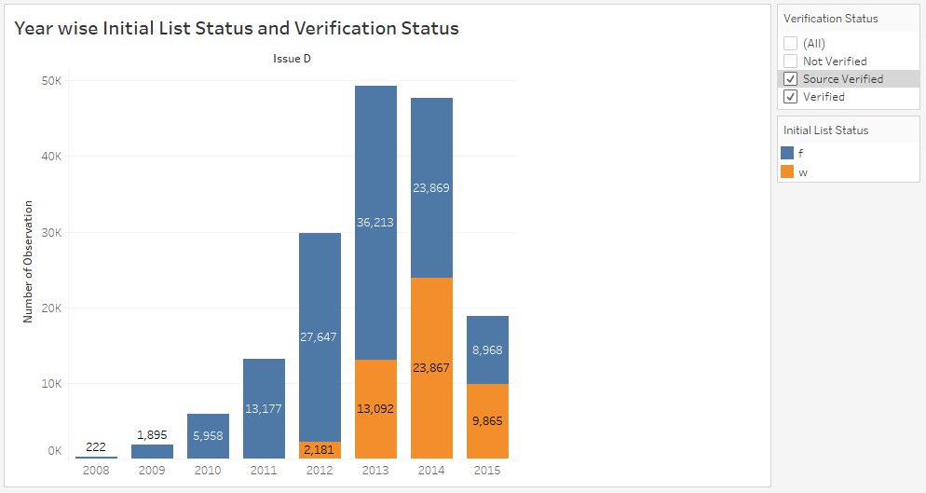

Slide 14
Data Cleaning
Parameter | Variable
Irrelevant | last_credit_pull_d, title, collection_recovery_fee, collections_12_mths_ex_med, funded_amnt, funded_amnt_inv, earliest_cr_line, id, member_id, sub_grade, pymnt_plan, last_pymnt_d, last_pymnt_amnt, next_pymnt_d, out_prncp, out_prncp_inv,emp_title, zip_code, recoveries, total_pymnt, total_pymnt_inv, total_rec_prncp, total_rec_int, total_rec_late_fee, inq_last_6mths, instalment,int_rate
More than 50% missing values | annual_inc_joint, dti_joint, desc, mths_since_last_delinq (51%MV), mths_since_last_major_derog, mths_since_last_record, verified_status_joint, open_acc_6m, open_il_6m, open_il_12m, open_il_24m, mths_since_rcnt_il, total_bal_il, il_util, open_rv_12m, open_rv_24m, max_bal_bc, all_util, inq_fi, total_cu_tl, inq_last_12m

Slide 15
Treating Outliers
For Treating Outliers the following common techniques are used :
Deleting observations
Transforming and binning values
Imputing
Treat separately

Slide 16
Data Cleaning
Data type:
1. Ordinal
"emp_length“, "grade"
2. Nominal
Label encoding:
["verification_status","purpose","term","home_ownership"]

Slide 17
Splitting data into train-test
Split using ‘issue_d’ variable
Train : From June 2007 to May 2015
Test : From June 2015 to Dec 2015

Slide 18
Data Preparation
Multicolinearity:
[ "installment“ , "int_rate“ ]
P-values:
[ "tot_coll_amt“ , “revol_bal“ , “acc_now_delinq“ ]

Slide 19
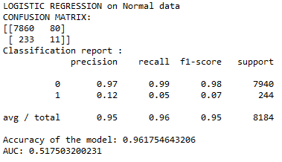
Model Building
Logistic Regression without upsampling :

Slide 20
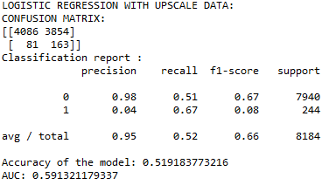
Model Building
Logistic Regression with upsampling :

Slide 22
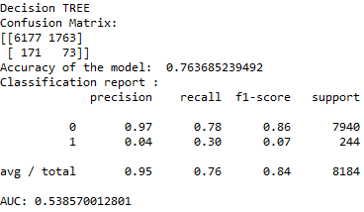
Decision Tree without upsampling:

Slide 23
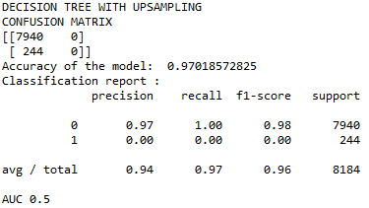
Decision Tree with upsampling:

Slide 25
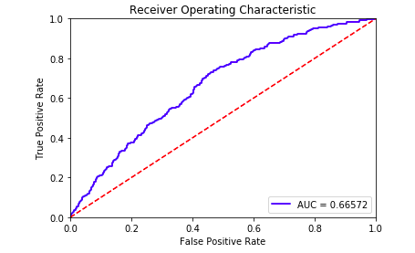
Xgboost without upsmampling :

Slide 26
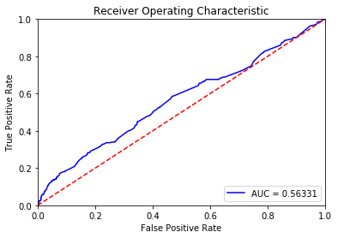
Model Building:
Xgboost with upsampling:

Slide 28
Conclusion:
Considering active customers dataset as validate data.
Running the best model on active customers dataset.
We Found that :
Class | Number of Records
0 | 575961
1 | 19346

Slide 29
Thank you

